Slide 1
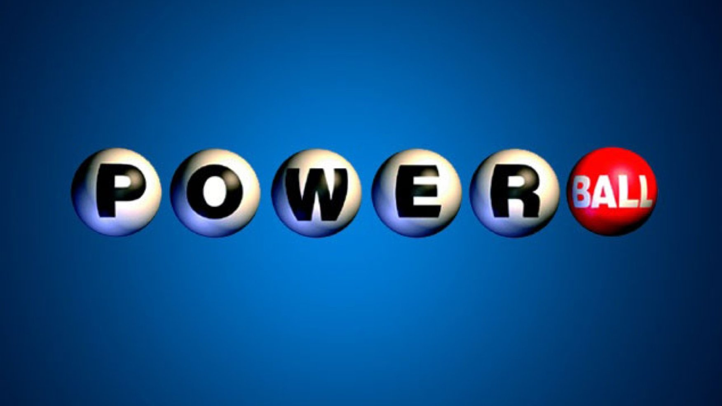
W A S H I N G T O N
Group 2
Erika Evergarden
Jamee Jones
Evan Woodard

Slide 2
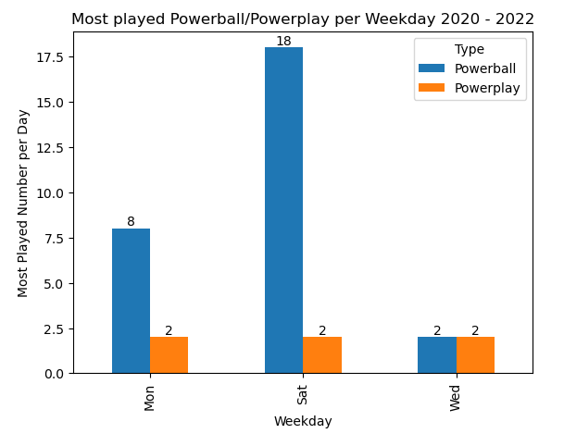
What were the most common powerball/power play numbers per day?
The “why”
The results

Slide 3
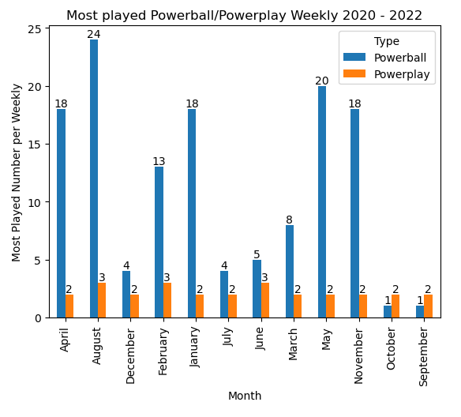
What were the most common Powerball/Powerplay numbers depending on the month?
Powerball numbers
Powerplay numbers
What does this mean?

Slide 4
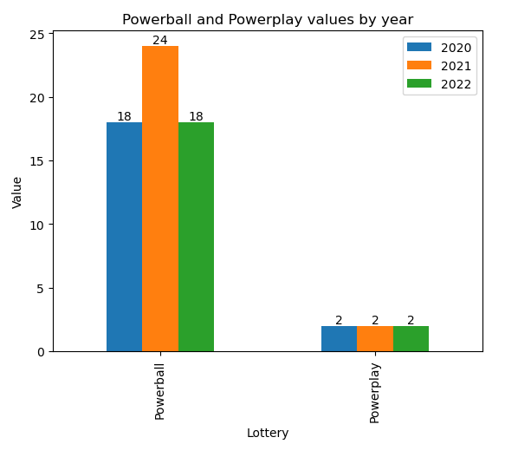
What were the most common powerball/power play numbers overall?
The “why”
The results

Slide 5
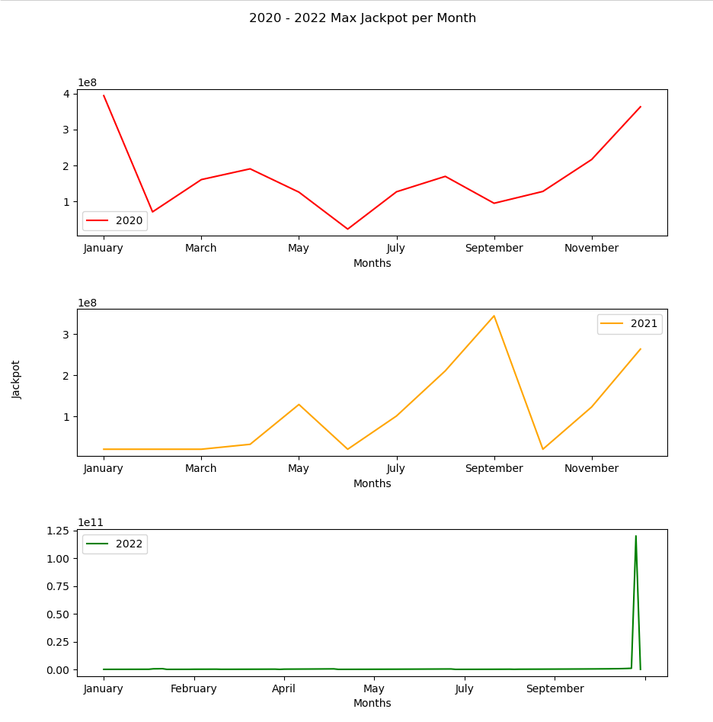
M
A
X
W
I
N
N
I
N
G
J
A
C
K
P
O
T
M
O
N
T
H
S
What are the top five greatest dollar months jackpot?
January 2020: $394,000,000
December 2020: $363,000,000
November 2020: $825,000,000
April 2020: $190,000,000
August 2020: $169,000,000
September 2021: $345,000,000
December 2021: $264,000,000
August 2021: $211,000,000
May 2021: $129,000,000
November 2021: $123,000,000
November 2022: $120,000,000,000
October 2022: $1,000,000,000
$825,000,000
$700,000,000
January 2022: $630,000,000

Slide 6
Which day of the week had the highest jackpot?
Year | Day | Amount
2020 | Wednesday | $394,000,000
2021 | Monday | $416,000,000
2022 | Wednesday | $120,000,000,000

Slide 7
Questions?

